Slide 1
Sectional Views

Slide 2
Sections and Sectional Views
A section is used to show the detail of a component, or an assembly on a particular plane which is known as the cutting plane.

Slide 3
Understanding Sections
Section views have three main purposes:
  Document the design and manufacture of single parts which are manufactured as one piece
  Document how multiple parts are to be assembled or built
  Aid in visualizing internal workings of a design

Slide 4
Full Sections
When a part is cut fully in half, the resulting view is called a full section
A line called the cutting-plane line shows where the object was cut and from which direction the section is viewed
  The arrows point toward the section being viewed

Slide 5
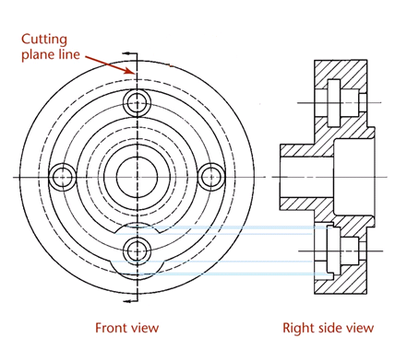
Full Section

Slide 6
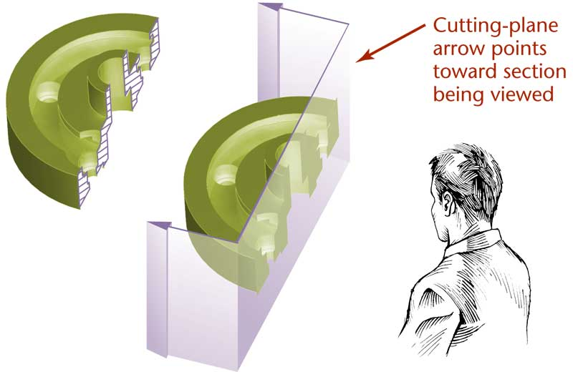
Full Sections

Slide 7
The Cutting Plane
The cutting plane is shown in a view adjacent to the sectional view
In the section view, the areas that would have been in actual contact with the cutting plane are show with section lining
  Those areas are cross-hatched

Slide 8
Lines Behind the Cutting Plane
The visible edges of the object behind the cutting plane are generally shown because they are now visible but they are not cross-hatched

Slide 9
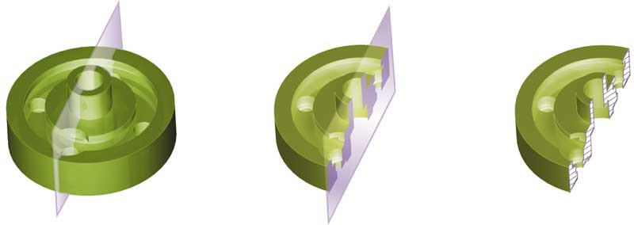
The Cutting Plane

Slide 10
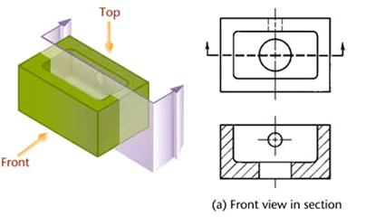
Placement of Section Views
Section views can replace the normal top, front, side, or other standard orthographic view

Slide 11
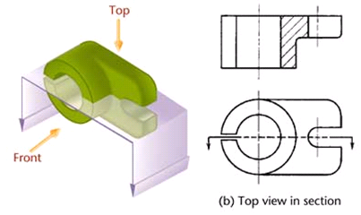
Placement of Section Views

Slide 12
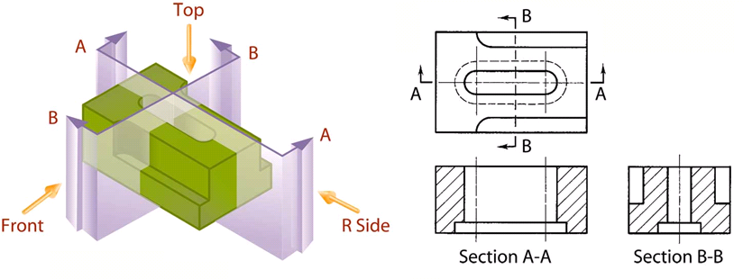
Labeling Cutting Planes
When more than one cutting plane is used, it is especially important to label them for clarity

Slide 13
Line Precedence
When a cutting plane coincides with a center line, the cutting plane line takes precedence
When a cutting plane line would obscure important details, just the ends of the line outside the view and the arrows can be shown

Slide 14
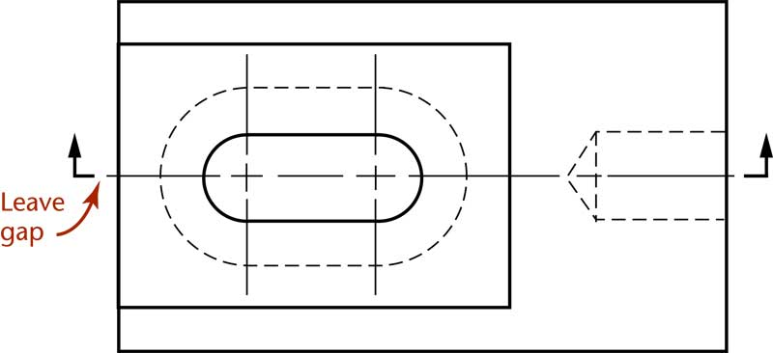
Line Precedence

Slide 15
Rules for Lines
Show edges and contours which are now visible behind the cutting plane
Omit hidden lines in section views
A section-lined area is always completely bounded by a visible outline
The section lines in all hatched areas for that object must be parallel
Visible lines never cross section lined areas

Slide 16
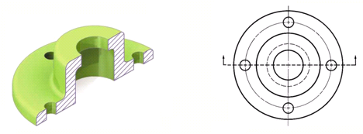

Rules for Lines

Slide 17
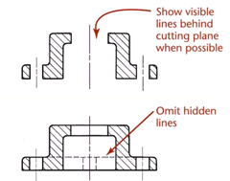
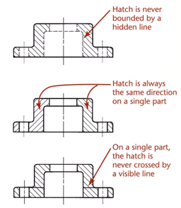
Section Line Mistakes

Slide 18
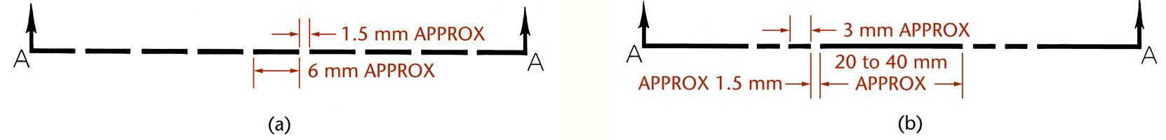
Cutting Plane Line Style
Cutting lines are thick lines (0.7 mm)
The preferred cutting plane line style is made up of equal dashes ending in arrowheads
  Another style uses alternating long dashes and pairs of short dashes

Slide 19
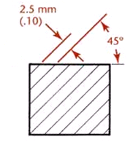
Section Line Technique
Uniformly spaced by an interval of about .10”
Uniformly thin, not varying thickness
Do not run beyond outer edges of the visible lines
Usually at 45˚ angle

Slide 20
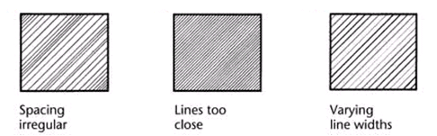
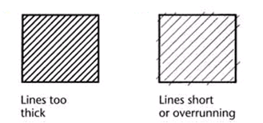
Section Line Mistakes

Slide 21
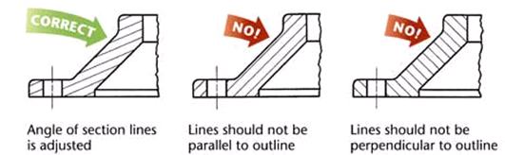
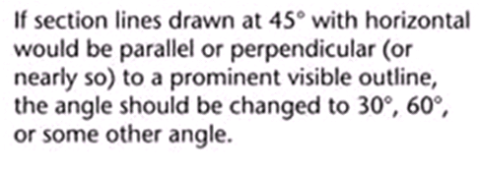
Section Line Technique

Slide 22
Section Lining Symbols
Section lining symbols may be used to indicate specific materials
Using different section lining patterns helps you distinguish different materials, especially on assembly drawings
  It is acceptable to use the general-purpose symbol at different angles for different parts

Slide 23
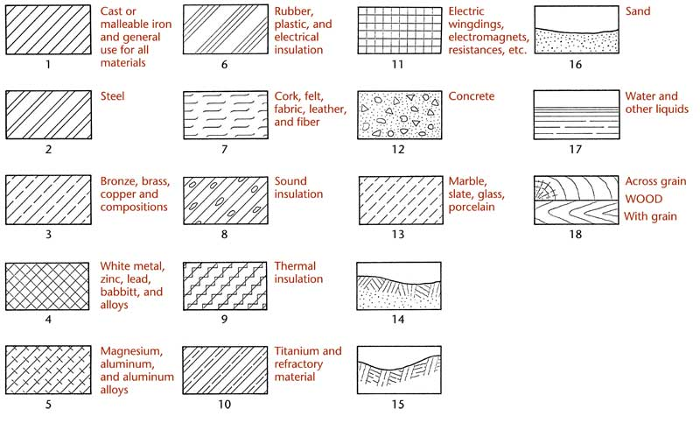
Section Lining Symbols

Slide 24
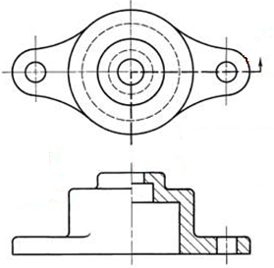
Half Sections
Objects that are symmetric can be shown effectively using a half-section
  Half sections expose the interior for one half of the object and the exterior of the other half
  One quarter of the object is removed

Slide 25
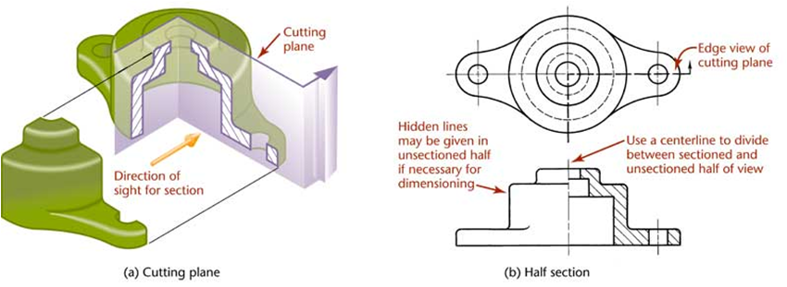
Half Sections
In general:
  Omit hidden lines from both halves of a half section whenever possible
  Use a center line to divide the sectioned half and the unsectioned half

Slide 26
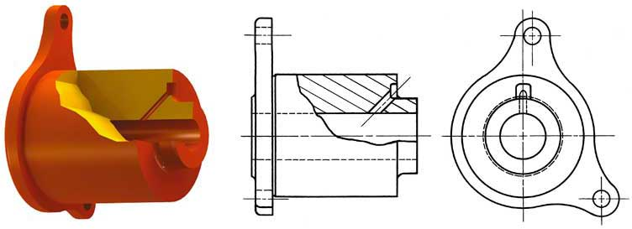
Broken Out Sections
Sometimes only a partial section of a view is needed to expose interior shapes
  Such a section, limited by a break line, is called a broken-out section

Slide 27
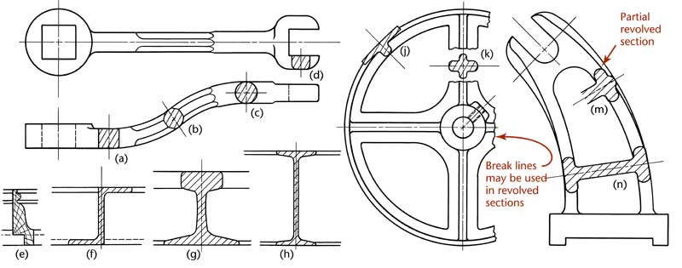
Revolved Sections
You can show the shape of the cross section of a bar, arm, spoke, or other elongated object by using a revolved section
  The visible lines adjacent to a revolved section may be broken out if desired

Slide 28
Removed Sections
A removed section is one that is not in direct projection from the view containing the cutting plane
  Removed sections should be labeled and arranged in alphabetical order from left to right

Slide 29
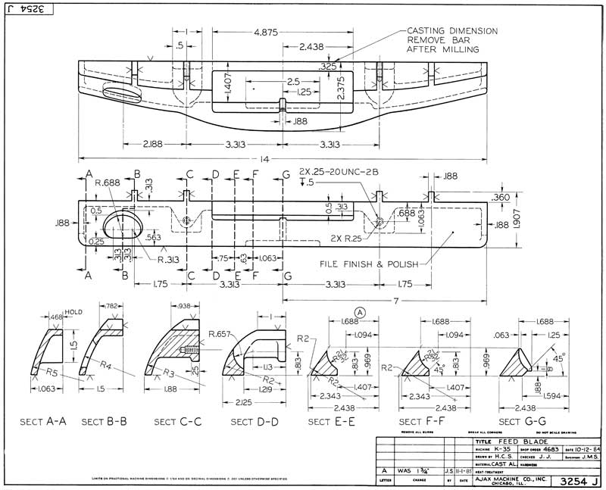
Removed Sections

Slide 30
Offset Sections
In sectioning through complex objects, it is often desirable to show features that do not lie in a straight line by offsetting or bending the cutting plane
  Offsets or bends in the cutting plane are all 90°
  The bends in the cutting plane are never shown in the sectional view

Slide 31
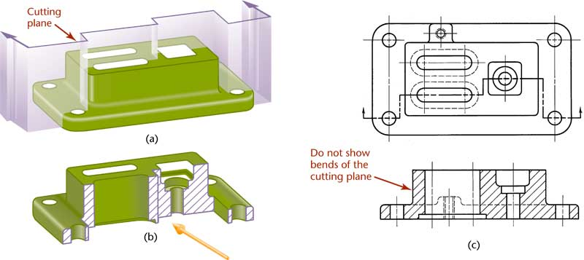
Offset Sections

Slide 32
Ribs in Section
To avoid a false impression of thickness and solidity, ribs, webs, gear teeth, and other similar features are not hatched with section lining even though the cutting plane slices them

Slide 33
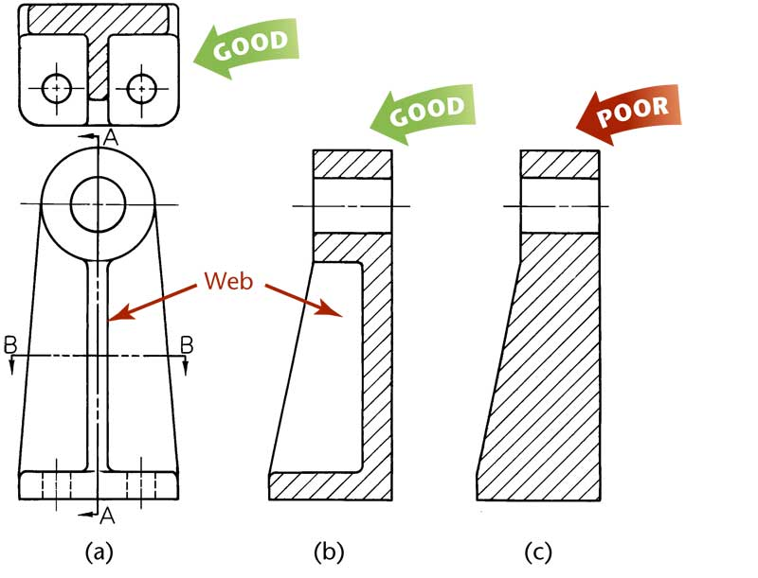
Ribs in Section

Slide 34
Aligned Sections
When sectioning parts with angled elements, the cutting plane may be bent to pass through those features
The plane and features are then revolved into the original plane
  The angle of revolution should always be less then 90° for an aligned section

Slide 35
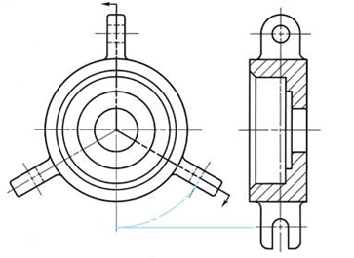
Aligned Sections

Slide 36
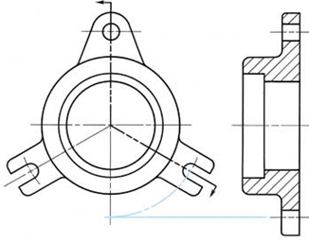
Aligned Sections

Slide 37
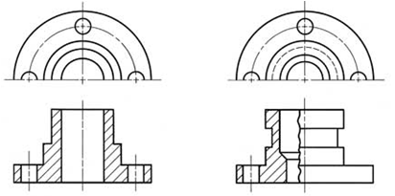
Partial Views
If space is limited on the paper or to save time, partial views may be used with sectioning

Slide 38
Conventional Breaks and Sections
Cross-hatching is often added when showing a conventional break
Conventional breaks are used to shorten the view of an object
  The breaks used on cylindrical shafts or tubes are often referred to as “S-breaks”

Slide 39
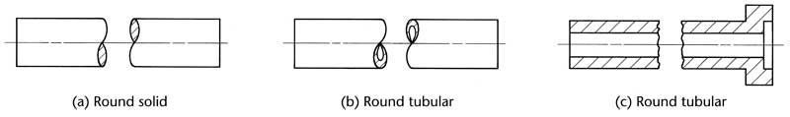
Conventional Breaks and Sections

Slide 40
Assembly Sections
Section views are often used to create assembly drawings
Different parts use different hatch patterns
Solid features that do not have interior structure are not hatched

Slide 41
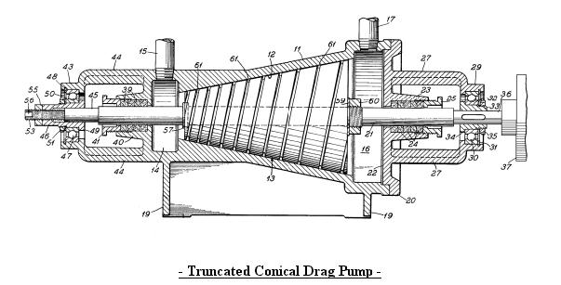

Slide 42
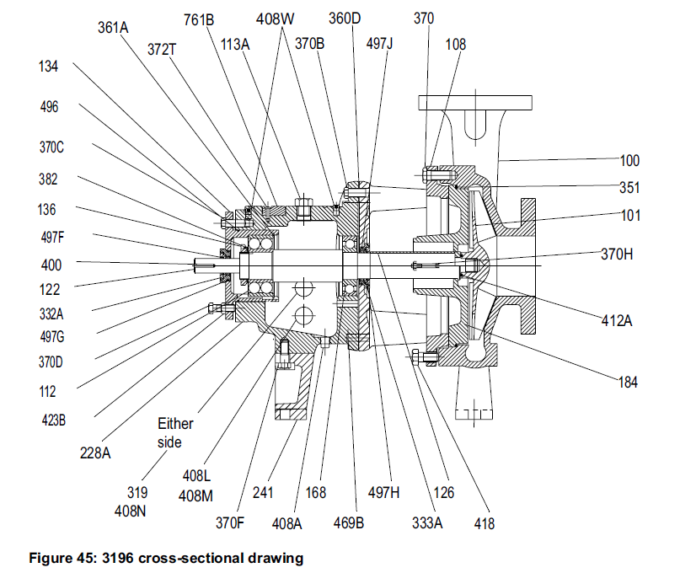
GOULDS PUMP

